Slide 1

Flavorful Moments
By: Shania Foster

Slide 2
Overview
Purpose
Built, Bought, or Both?
Why my product?

Slide 3
Tools & Budget
Wordpress.org
Theme – $20
Dreamhost.com
Domain Name & SSL/TLS Certificate - Name – $4.95

Slide 4
Integrations
WooCommerce
Menu Cart
Payments
Extra Product Options
Theme

Slide 5
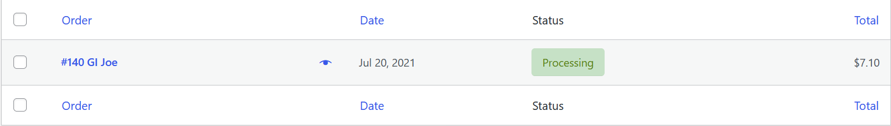
Behind the Scenes – Integrations
Viewing Payments/Orders

Slide 6
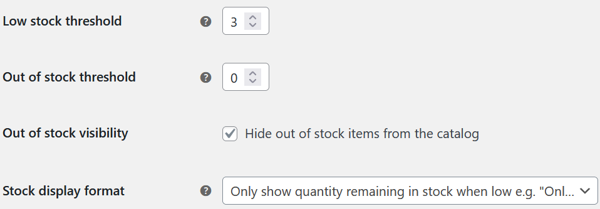
Behind the Scenes – Integrations
Viewing Product Stock

Slide 7
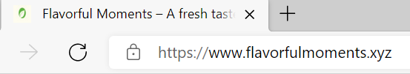
Security
SSL/TLS Certificate

Slide 8
Challenges
Designing the look of my Website
Finding Plugins
Product Display

Slide 9
LIVE DEMO

Slide 10
Future Developments
Better Quality Pictures
Updated Look of Website
More Features
More Product Options
Updated Cart Checkout

